Slide 1
خوش آمد ید ۔

Slide 2
Presentation on urdu Nasar
Presented by
DR. Sabiha Sayyad From Night College of Arts and Commerce ,Ichalkarnaji. Urdu Department

Slide 6
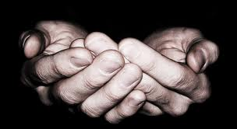
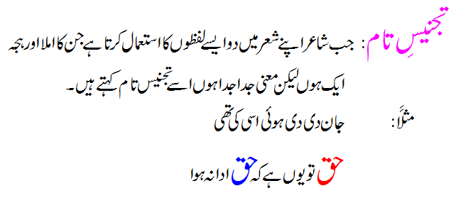
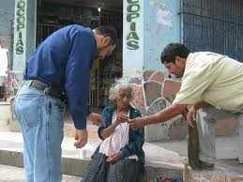
حق: سچ
حق: فرض

Slide 7
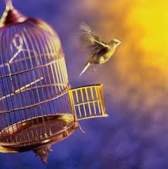
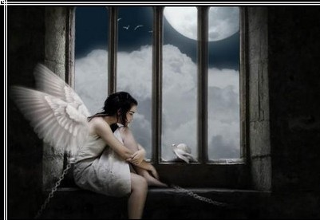

Slide 8
Thank You

